Slide 1
There’s a lot Happening...
in Teacher Development
Prof Sam Twiselton
Director of Sheffield Institute of Education
Chair DfE ITT Core Content Group
Vice President of CCT
s.twiselton@shu.ac.uk
@samtwiselton

Slide 2
The teacher development journey
My research
Policy Development
Recruitment and Retention

Slide 3
The teacher development journey
My research
Policy Development
Recruitment and Retention

Slide 4
Decisions - moment by moment in the classroom
Task Manager
Curriculum Deliverer
Concept/skill Builder
Three types of teacher - or three points on a sliding scale:
It was in the scheme – that’s the main reason
Really I was just concentrating on getting it done.
I wanted to show them in different ways - help them see what it was all about.
Classrooms should look busy and orderly. Children should complete their tasks. Teachers should be in control.
Learning is dictated by someone else. It is hard to give a reason why the learning is important beyond this.
The subject and why it matters - concepts and skills are key - transferable and transformative learning

Slide 5
https://www.suttontrust.com/wp-content/uploads/2014/10/What-Makes-Great-Teaching-REPORT.pdf
Poor Proxies for Learning - Prof Rob Coe
Students are busy: lots of work is done (especially written work)
Students are engaged, interested and motivated
Students are getting attention: feedback, explanations
Classroom is ordered, calm, under control
Curriculum has been 'covered' (i.e. presented to students in some form)
(At least some) students have supplied correct answers, even if they:
have not really understood them
could not reproduce them independently
will have forgotten by next week (tomorrow?)
already know it

Slide 6
What makes great teaching? Review of the underpinning research: Coe, Aloisi, Higgins and Elliot Major, October 2014
Poor Proxies for Learning - Prof Rob Coe
Students are busy: lots of work is done (especially written work)
Students are engaged, interested and motivated
Students are getting attention: feedback, explanations
Classroom is ordered, calm, under control
Curriculum has been 'covered' (i.e. presented to students in some form)
(At least some) students have supplied correct answers, even if they:
have not really understood them
could not reproduce them independently
will have forgotten by next week (tomorrow?)
already know it
Classic Task Manager

Slide 7
What makes great teaching? Review of the underpinning research: Coe, Aloisi, Higgins and Elliot Major, October 2014
Poor Proxies for Learning - Prof Rob Coe
Students are busy: lots of work is done (especially written work)
Students are engaged, interested and motivated
Students are getting attention: feedback, explanations
Classroom is ordered, calm, under control
Curriculum has been 'covered' (i.e. presented to students in some form)
(At least some) students have supplied correct answers, even if they:
have not really understood them
could not reproduce them independently
will have forgotten by next week (tomorrow?)
already know it
Classic Curriculum Deliverer

Slide 8
So what makes an expert teacher and how can we help?

Slide 9
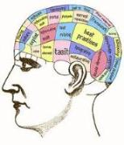
Teacher Expertise
Sternberg and Horvath
Knowledge
Subject knowledge matters
How it is organised matters more than how much
Insight
Efficiency

Slide 10
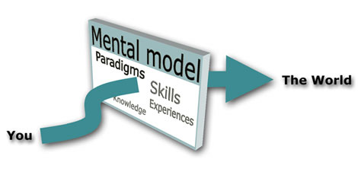
Mental Models and Schema
Knowledge
Insight
Efficiency
Cognitive schemas - channel thinking by the selection, retention and use of information. Specify which elements of information are essential and how they relate to each other. Schemas serve as guides to action

Slide 11
Big Picture
Detail

Slide 12
A developmental continuum?
Near the beginning of ITE
Task Manager
Likely to revert
Next stage of development
Curriculum Deliverer
Can get stuck
External factors influential
Aiming for
Concept/ Skill Builder
Bigger picture
Dialogue
Compare/contrast/ critique
A continuum or a cycle?
A vicious circle?
A trap to try and avoid?
Messier than all of the above!

Slide 13
Teaching experiences
Observation
Deconstruction
Spiral Curriculum
Assimilation
Inputs
Critical reflection
ITE Curriculum Considerations
Task Management – Behaviour - Engagement
Curriculum Delivery - Content Coverage
Concept/Skill building - understanding and application over time
Crafting and Sequencing of Experiences

Slide 14
The teacher development journey
My research
Policy Development
Recruitment and Retention

Slide 16
The teacher development journey
My research
Policy Development
Recruitment and Retention

Slide 17
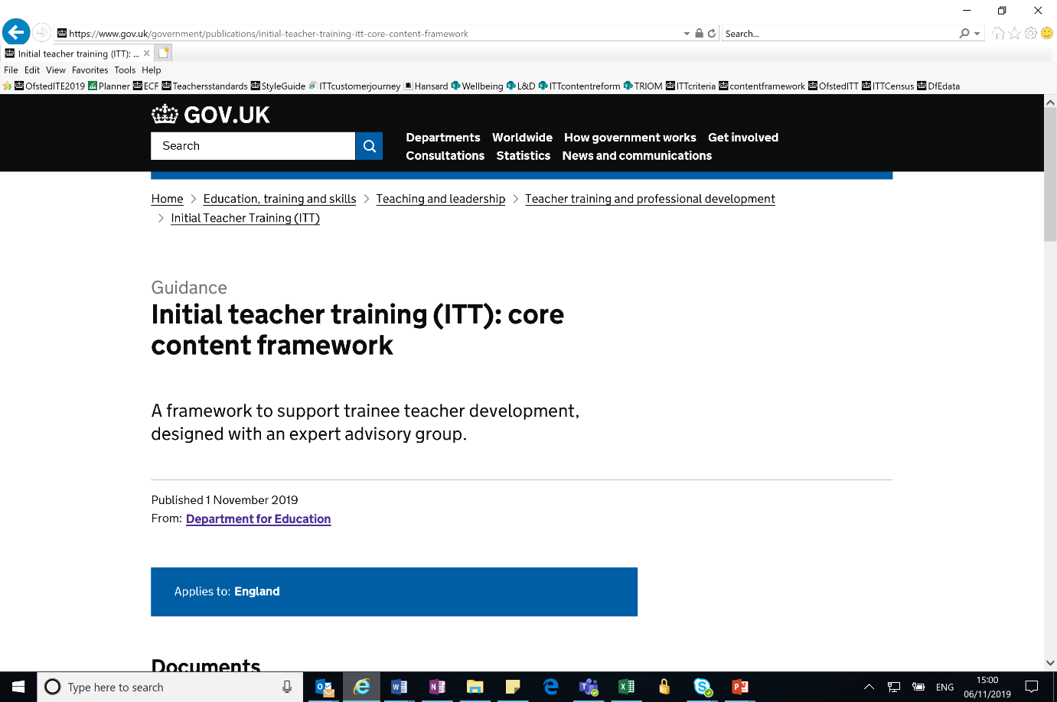
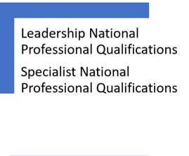
A Short History of Teacher Development Policy

Slide 18
The scope of the Carter Review of ITT
All ITT routes (HEI, SCITT, School Direct as well as Teach First) and subjects/phases.
The Advisory Group
Professor Samantha Twiselton (Sheffield Hallam University)
Dr Louise Walker (Manchester University)
Sir Dan Moynihan (Harris Federation)
Judith O’Kane OBE (Bright Futures Education Trust)
Daisy Christodoulou (ARK Schools)
The Review Process
A review of the existing evidence base
A call for evidence that received 148 responses
11 themed roundtable discussions with sector experts
24 meetings and discussions with experts and stakeholders
31 visits to ITT providers and schools involved in ITT
A review of course materials from ~150 programmes.
A survey of trainee and applicant opinions about ITT course information

Slide 19
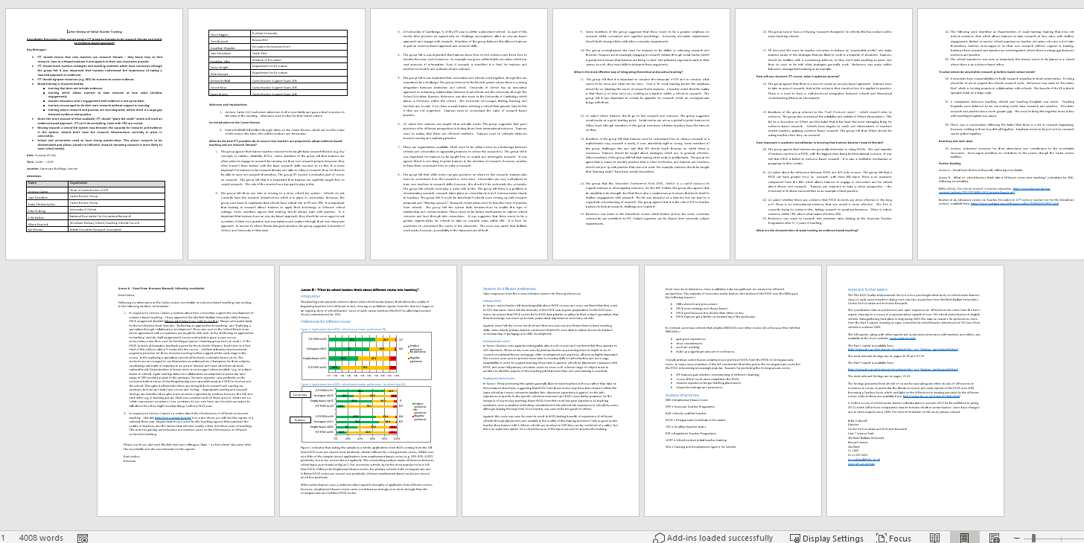
Notes from Subject Knowledge Round Table = 11 pages - similar for all the others

Slide 20
REFLECTIONS ON CARTER/ITT framework
The review found a lot of very good practice BUT:
An inconsistent picture as to what is included and how it is delivered
The best carefully craft and integrate types of knowledge and experiences HOW, WHO, WHERE, WHEN and HOW OFTEN as important (if not more) than WHAT
Some MATs and TSAs create a seamless join from ITE to NQT/RQT but this is variable regionally and nationally
The system is fractured nationally and regionally - coordination is lacking systemically
ITE IS NOT LONG ENOUGH AND NOT SUFFICIENTLY JOINED TO EARLY CAREER SUPPORT

Slide 23
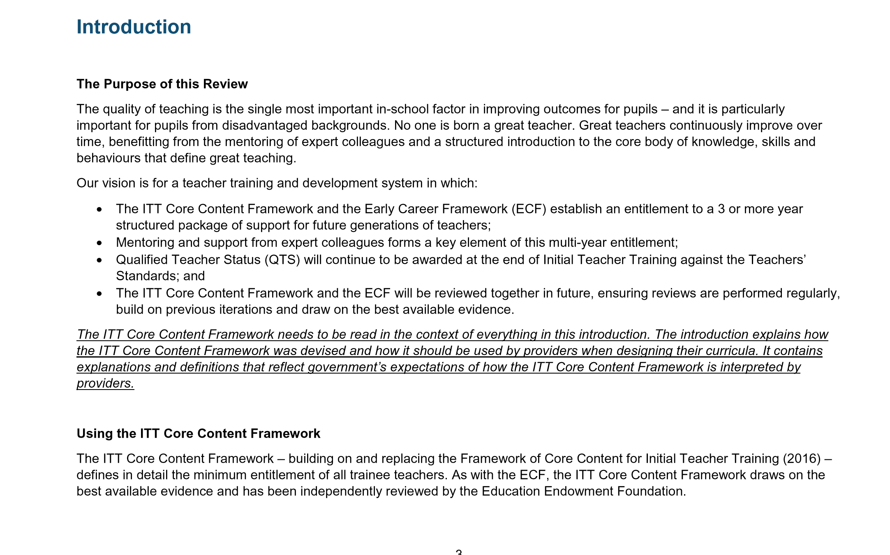
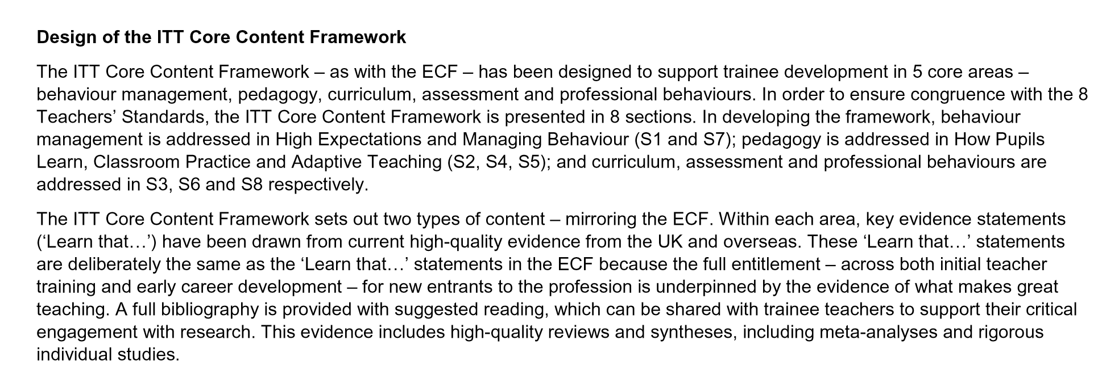
Understanding what it is and what it isn’t
READ IT!
https://www.gov.uk/government/publications/initial-teacher-training-itt-core-content-framework
Notes:
Possible discussion on the layout and content of framework

Slide 24
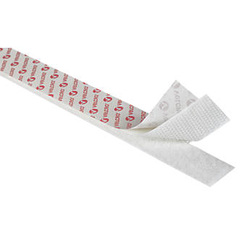
Aims of the ITT Core Content Framework
A core minimum entitlement.
To work coherently with the ECF to ensure all new teachers benefit from at least 3 years of evidence-based training, across ITT and into induction.
To support more trainees to successfully enter and remain in the profession.

Slide 25
Early anecdotal impressions
The ‘framework not curriculum’ message needs emphasizing but is then welcome
Sequencing and crafting of experiences is key
Some terminology is less familiar but benefits from critical analysis and relating to more familiar models
The ‘expert colleague’ term needs unpacking but this prompts a useful conversation (see next slide)
Covid has clearly thrown up many challenges but also some opportunities

Slide 26
The many moving parts of R+R

Slide 28
Reformed Suite of NPQs
Section map showing how professional development is a thread between all the new NPQ frameworks
Leading Teacher Development
Teaching (Consolidation of ECF)
Designing Professional Development
Delivering Effective Professional Development
Implementation
Leading Teaching
Teaching (Consolidation of ECF)
School Culture
How Pupils Learn
Subject and Curriculum
Classroom Practice
Adaptive Teaching
Assessment
Professional Development
Implementation
Leading Behaviour and Culture
Teaching (Consolidation of ECF)
School Culture
Enabling Conditions for Good Behaviour
Complex Behavioural Needs
Professional Development
Implementation
Senior Leadership/ Headship/Executive Leadership
Culture
Teaching
Curriculum and Assessment
Behaviour
Additional and Special Educational Needs and Disabilities
Professional Development
Organisational Management
Implementation
Working in Partnership
Governance and Accountability

Slide 29
Who is it for?
Teachers who currently have or are aspiring to have responsibilities for leading the development of other teachers in their school
Likely to be part of the middle leadership team (but roles vary)
May manage a team of mentors or coaches (directly or indirectly)
Primary or secondary
Working in any type of school (including special schools)
Role may include supporting: - trainee teachers (ITT) - early career teachers (ECF) - and/or wider development of school colleagues
Teacher Developer

Slide 30
Questions and comments

