Slide 1
Coaching NQTs
Matthew Sossick
University of Roehampton

Slide 2
Key ideas
Gu and Day (2007)- Equilibrium and Sense of Agency – but this agency can be threatened by mentoring on occasions rather than supporting it
Resilience complex interplay between environmental and personal pressures and protective factors (Bernard, 2004, Mansfield, Beltman and Price 2014, Gu and Day, 2013).
‘Judge-mentoring’ (Hodson and Malderez, 2013)– issues with mentors who lack time and training and act as gatekeepers to the profession passing judgements whilst reinforcing what they see as norms.
Marion Jones (2009) multi-support models that recognise value of ‘humanistic, person-centred aspects of mentoring’
Mcintyre and Hobson (2016) – Coaching as a ‘third space’
Idea of witnessed failure in an arena
Notes:
Is there a sense of blnce where the protectors are balancing out the stressors?
Resilience as not being an innate quality but rather the way envoronmenal pressues affect the self – as such resilience can be affected for better or for worse in school environments. This mixes with the personal pressures some put on themselves – the perfectionist who leaves the profession early because the comination of the workload and their own expectations is too much.
One of the stressors maybe the type of entoring that they receive – performativity, accountability cultures that can pit the Mandated top down aspects of metoring against the humanistic nurturing aspects of traditional conceptions of mentoring – Mullen,2012
Judegemwntoring

Slide 3
Coaching Project
Who
7 NQTs – chosen because they had achieved at different levels in training year. Schools that were happy to participate.
Where
In their schools. Recognising the demands of their role and that Resilience is contextual
When
Half termly – starting after the October Half Term – when the ‘honeymoon’ period ‘is over’.
How
Based on the i-Resilience Research of Cooper and Robertson, we devised prompts and discussion tools for each area of Confidence, Adaptability, Purpose and Drive and Social Structures.

Slide 4
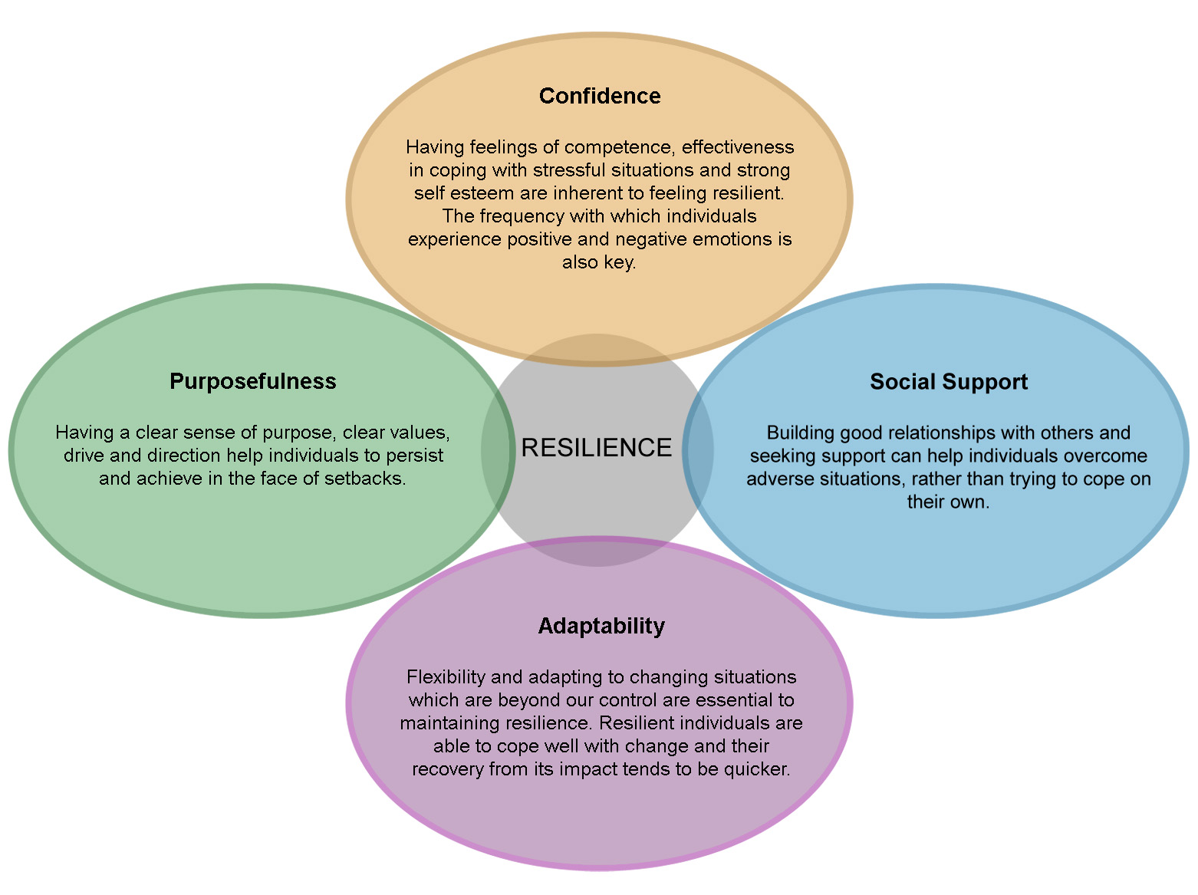
i-Resilience : 4 Key Components of Personal Resilience
Notes:
Let’s look at these four key components of personal resilience (RC nb) in a bit more detail from the perspective of a trainee teacher. We use these lenses for discussions with the trainees.
Purposefulness – From my research, the resilient trainees have a clear sense of purpose and the ethos of the school closely aligned. They are working with mentors and PCMs who clearly care about their progress as a trainee.
Adaptability – open-mindedness and flexibility; for a trainee who moves from one school to another as part of their training, this can be challenging. Different and sometimes conflicting feedback e.g.
Social support – family and friends, of course … but professionally the trainees have one another and tutors, their mentor, other school colleagues, PCM, wealth of reading to support and guide professional development.
Confidence – Comes with good subject knowledge (subject-specific and pedagogy) and positive relationships – this requires self-awareness and hard work!
My notes – see robertson and cooper website with free online test we could use as basis for discussions
Get them to focus on the positives as well as negatives
Mentors feedback on positives so there is a good balance
Previous trainnees talk about importnace of having some time off
After experiences get them to use metaphors to describe whatvthey are doing
What could youbhave done to cope better and what will you as an NQT
The

Slide 5
Key themes emerging from research interviews
Workload
Support
Behaviour
Fear of failure

Slide 6
What did the NQTs themselves say?
“I think the first couple of months were really tough, hitting the ground running and establishing routines. Organisation is really key. There were times, staying up really late doing loads of work and thinking ‘is it going to be like this all the time?’. That got to me the most.”
“So you would have the Head coming and saying this needs to be done and then someone else says this needs to be done. Then you would go to a staff meeting and come out with another ten things to do, whilst you knew you had marking to do, planning to do and a something else to do. It gets to that pressure cooker where you feel like you are going to explode. And it is like’ Whoa! What is the priority?’”
Notes:
Workload and their ability to find coping strategies - particularly in the first term.
The sheer breadth/scale of the expectations of an NQT.
The need for explicit training in prioritisation.

Slide 7
Prioritising workload
“I don’t think schools are good at prioritising and you know that everyone is going to say, ‘This is what needs to be done’. Whereas when you come from a business perspective, it is much more about team work and you have the discussion about what is more important and what doesn’t get done. Obviously if you have a parent meeting then that has to over-ride everything else, but it is just physically impossible to get it all done.”

Slide 8
Support
My mentor was head of year 6 and a member of SLT as well. We haven’t spoken to each other in a long time. I really like her and we got on really well but she is very busy with what she is doing. She is moving to a bigger school with a bigger role. I didn’t have as much time with her as I probably would have like to. She was still approachable and I would go and talk to her. In the beginning she was quite proactive in coming to see me once a week but then that sort of faded.
Notes:
Lack of Support from the Schools that they worked in.
Mentor support being cancelled, not given as NQT projected an external ‘image of competence’, to postponed due to time pressures.

Slide 9
The only time I’ve spoken to the head teacher is when they are unhappy because in their view a parent is unhappy even though the parent is unstable and they want me to do more for this child but I couldn’t do more. I know it sounds a bit childish to say I need a bit of praise but come on that’s how we get a child to behave; it should work for the teachers.

Slide 10
Behaviour/Support/fear of failure
I think they [senior management] think I’m weak because my class has difficult behaviour. When I say I have a very difficult class they say it doesn’t make a difference, if you want to be to be a teacher…so there is no kind of feeling of acknowledgement, and so I don’t have that perspective
Notes:
Pupil behaviour - NQTs questioned the support they got to deal with these matters from line managers. No-one came to ask, ‘Are you okay?’
They had no measure of what was perceived as ‘normal’ behaviour’
Fear of Failure - this seem to inhibit the NQTs self-efficacy - not seeking help or having open dialogues about issues that they were experiencing.

Slide 11
The benefits of coaching
“having someone completely objective…”
“[The coach] would probe and ask questions and that would shed new light on why it wasn’t working…”
“different perspective”
“He helped to develop me as a teacher, definitely my resilience. I really looked forward to the meetings. It was the thing that got me through.”

Slide 12
Key Threads that came from the Project
We need to consider having external NQT mentors as an ‘objective other’. Or, with ever greater collaboration between schools this could become a reciprocal arrangement.
Schools and ITTs need to put in explicit training to support NQTs with their prioritisation skills.
We need to reassure our NQTs more to allow them to overcome their ‘fear of failure’ and allow them to be honest about the challenges of being a class teacher for the first time.
There needs to be a greater focus on behaviour. What is the acceptable ‘norm’? NQTs need to observe more experienced colleagues working with their children to get a sense of this.
We need more frequent networking opportunities for NQTs to come together and, through support, be coaching collectively.
We need to raise the status of mentors in school to allow busy teachers the time and the space that they need to nurture their NQT(s).

Slide 13
Benefits, that NQTs noted of the Resilience Coaching.
As an opportunity where the NQTs felt that they could ‘let off steam’
A less judgemental environment than the traditional mentor-NQT situation.
An opportunity for the NQTs to recalibrate.
A reminder to the NQT of the ‘bigger picture’ and why they came into teaching.
As independent from the school who they could talk openly to about their experiences.
As allowing you to analyse the situation in a different way.
As reassuring in having someone to help keep matters in perspective.
As an experienced voice of support

